Slide 1
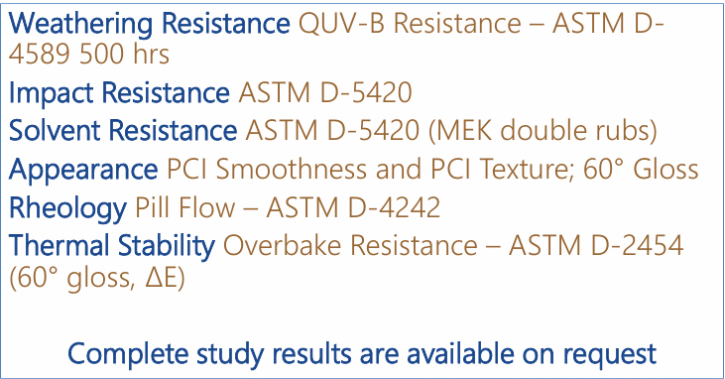
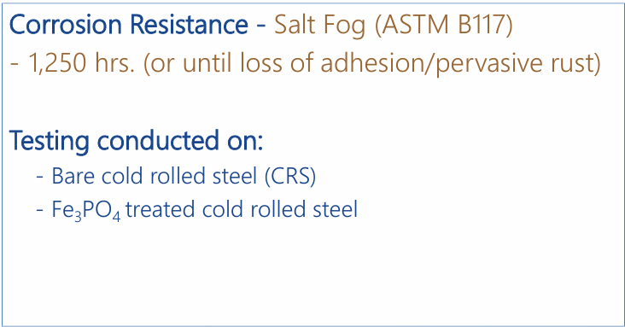
Testing performed on GraphShield 730

Slide 2
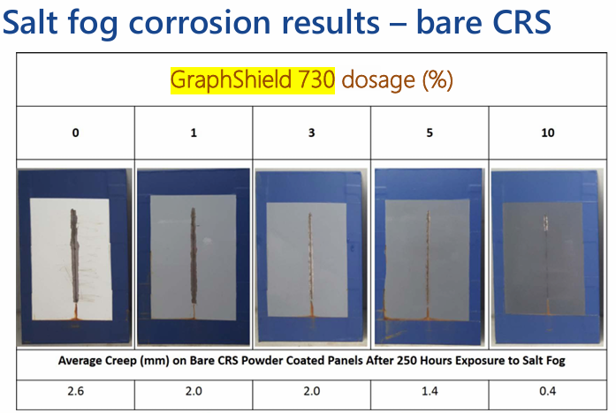
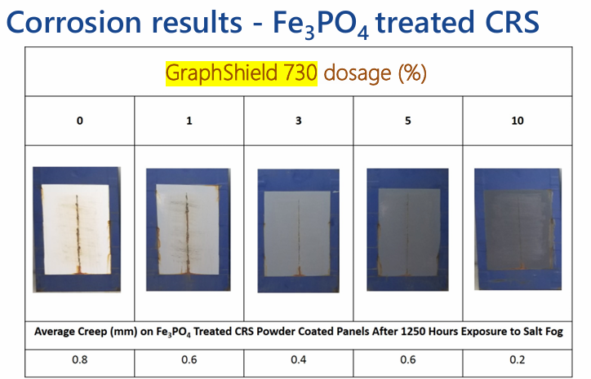
Anticorrosion

Slide 3
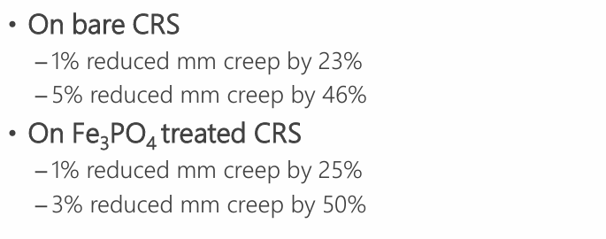
GraphShield 730 Anticorrosion results

Slide 4
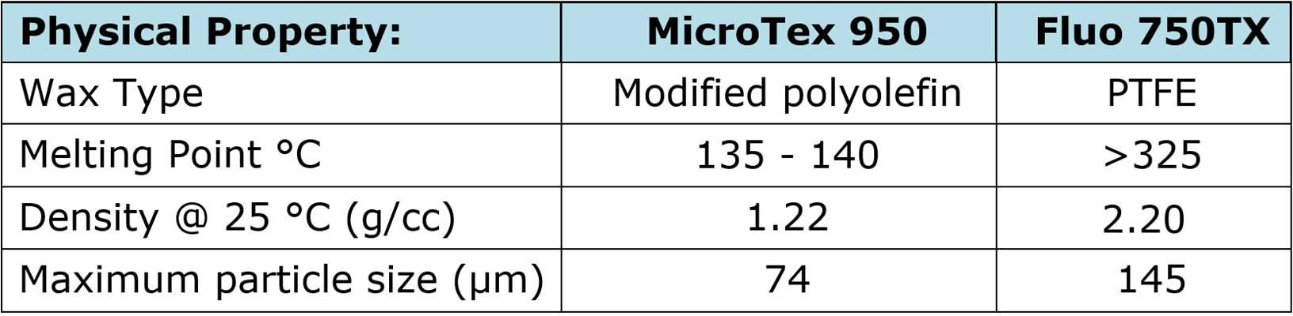
Performance Study
Objective: Evaluate the texture and gloss performance of MicroTex 950 vs. Fluo 750TX in various powder coating systems

Slide 5
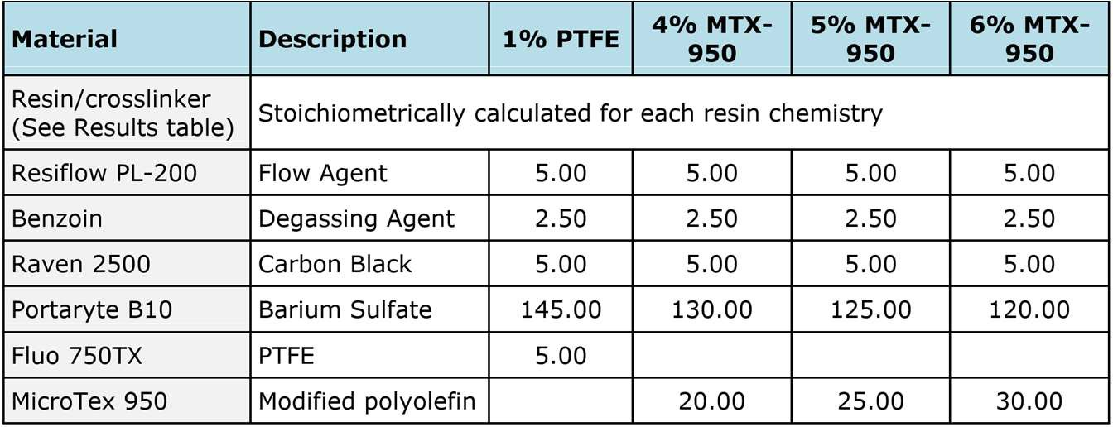
Control Formulas
Resins:
Epoxy-Polyester Hybrid
Polyester-TGIC
Polyester-HAA (Primid)
Each system was evaluated with 1.0% Fluo 750TX vs. 4-5-6% MicroTex 950

Slide 6
Test Methods Beyond the Visual
Specular Gloss (ASTM D2457)
60° geometry
Impact Resistance (ASTM D2794) “falling weight test”
Measures resistance of a paint film from rapid deformation (inch/lb.)
Conical Mandrel Bend (ASTM D522)
Measure of flexibility (crack resistance) 130°
Crosshatch Adhesion (ASTM D3359)
Tape test to measure adhesion
Pellet Flow (ASTM D3541)
Measurement melt flow under low shear

Slide 7
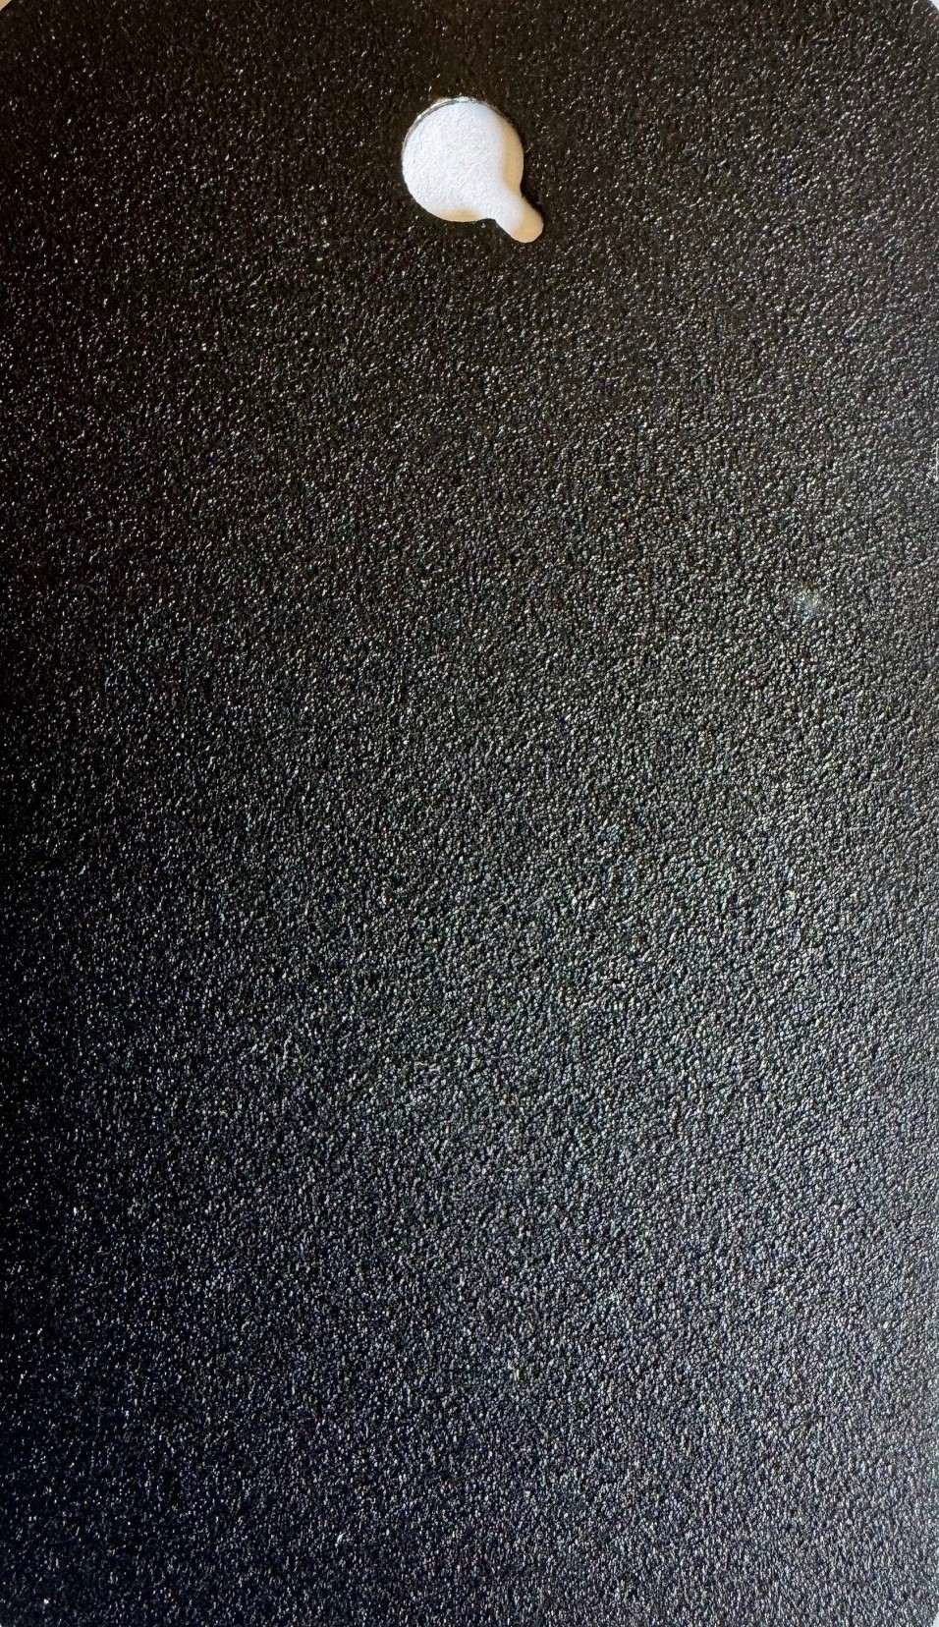
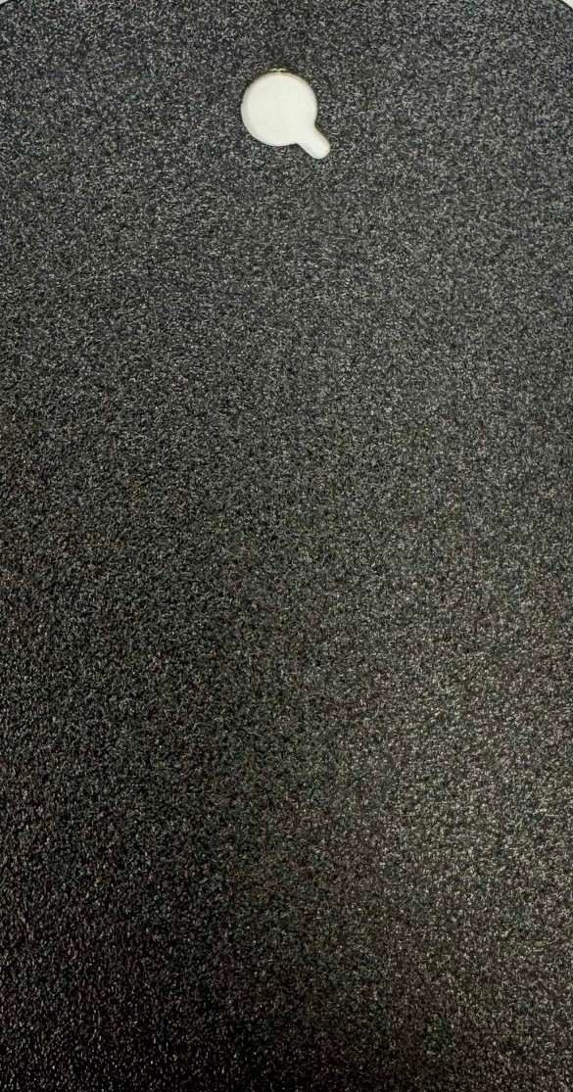
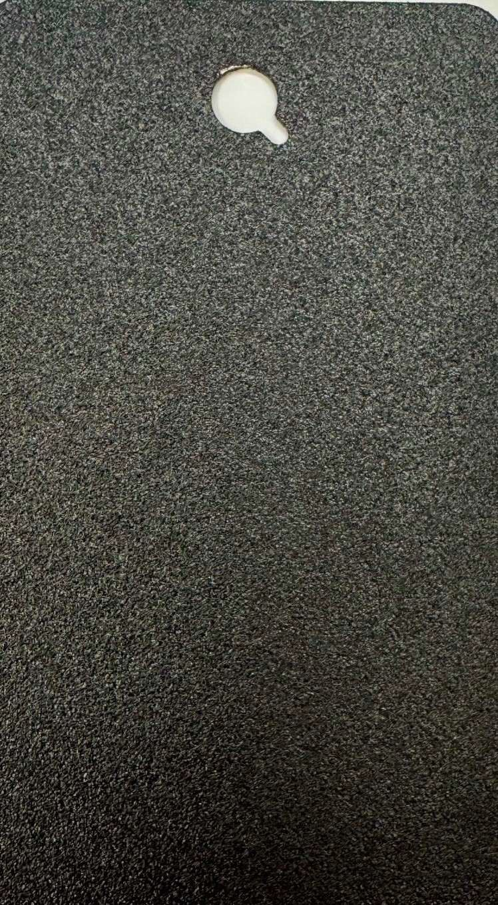
Visually our best replacement for Fluo 750TX
1.0% Fluo 750TX Hybrid
6.0% MicroTex 950 - Polyester TGIC
6.0% MicroTex 950 - Polyester HAA

Slide 8
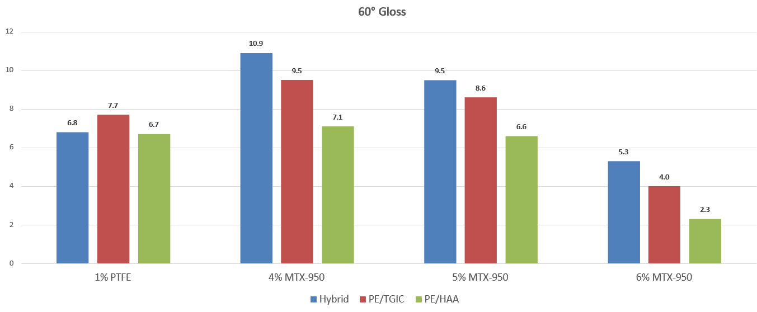
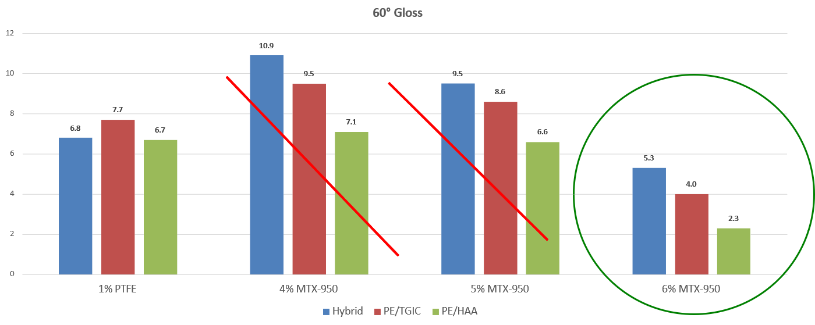
Gloss Efficiency

Slide 9
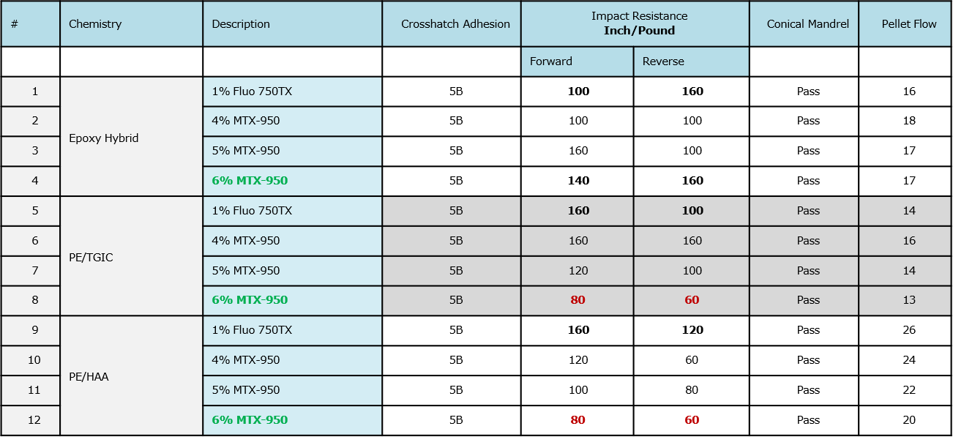
Mechanical Properties

Slide 10
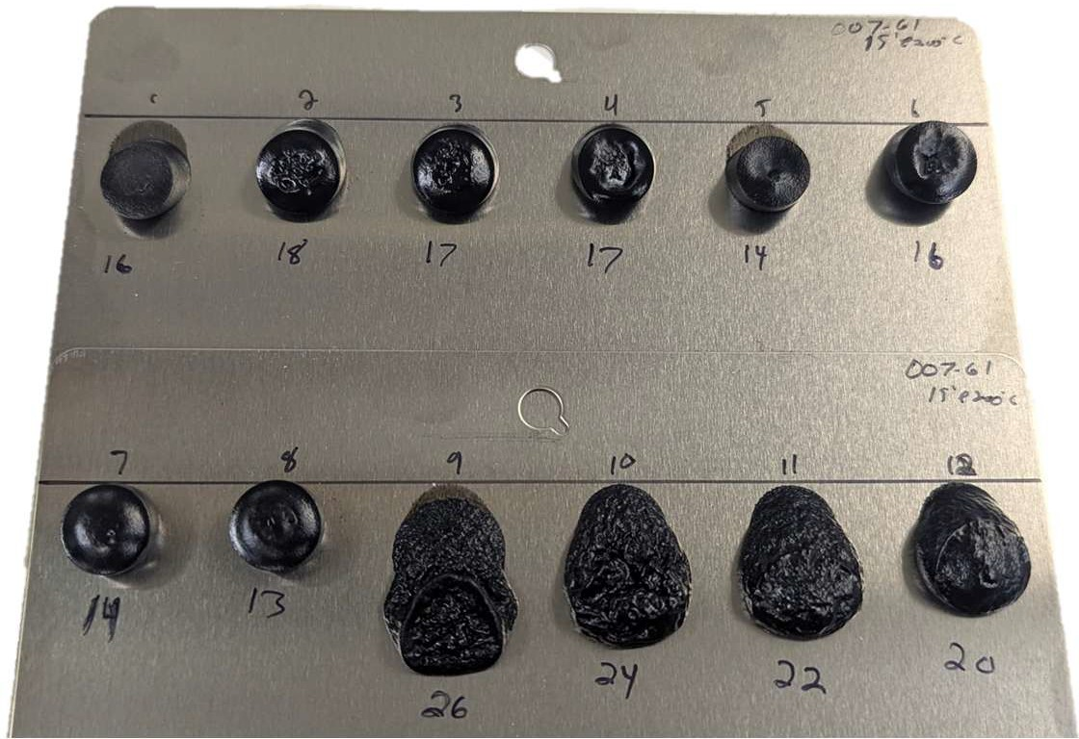
Inclined Plate – Pellet Flow at 15 min/200°C
(indication of edge coverage)
#1-4 Hybrid Suitable flow for texture
#5-8 PE/TGIC
Suitable flow for texture
#9-12 PE/HAA
Expand & contract as they shed water during cure
50

Slide 11
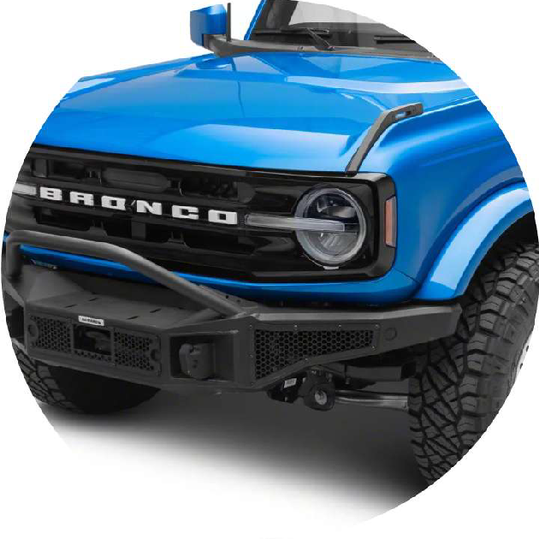
Conclusion
Visually MicroTex 950 is the closest match to Fluo 750TX
Single digit gloss (<6 gloss units/60°)
No negative effect on cross hatch adhesion or mandrel bend
Impact resistance was slightly lower in the polyesters versus the epoxy hybrid
Pellet flow indicates minor restricted flow; good for appearance and edge coverage in texture finishes
We are receiving very positive customer feedback and approvals worldwide
51

Slide 12
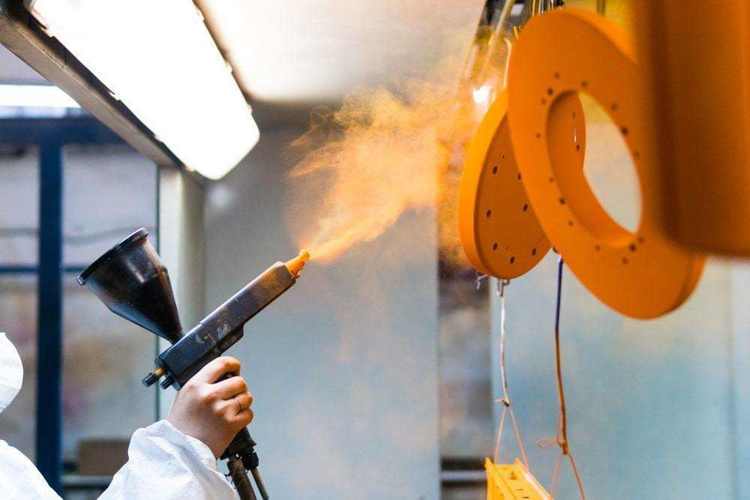
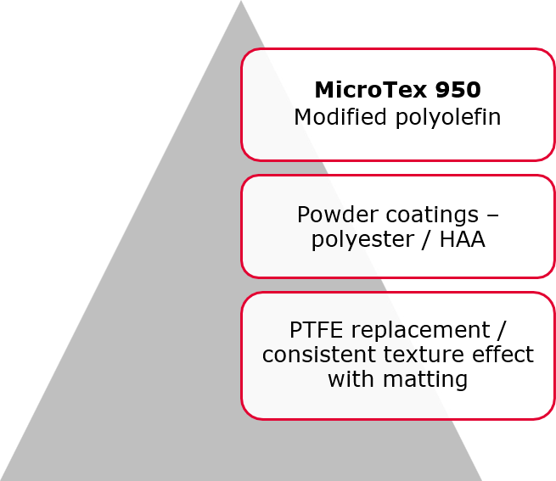
France:Axalta

Slide 13
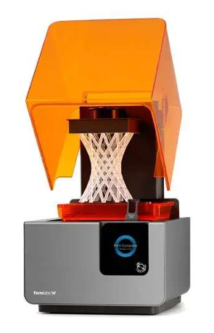
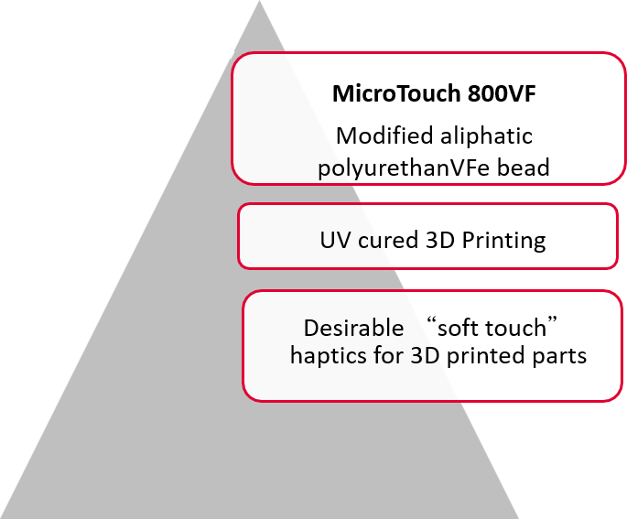
USA: Spectra Photopolymer

Slide 14
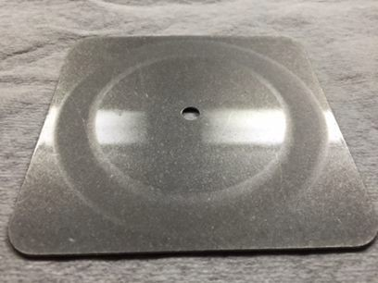
Performance Study Overview
Compare the following PropylMatte grades
PropylMatte 31, PropylMatte 31HD & PropylMatte 31SA
Clear waterborne 1K polyurethane dispersion
Preparation
Reichhold Urotuff L63-MPW38
Level of addition at 4.0% TFW
#60 rod - 6.0 mil WFT
S-18 Taber panels
Dried one week

Slide 15
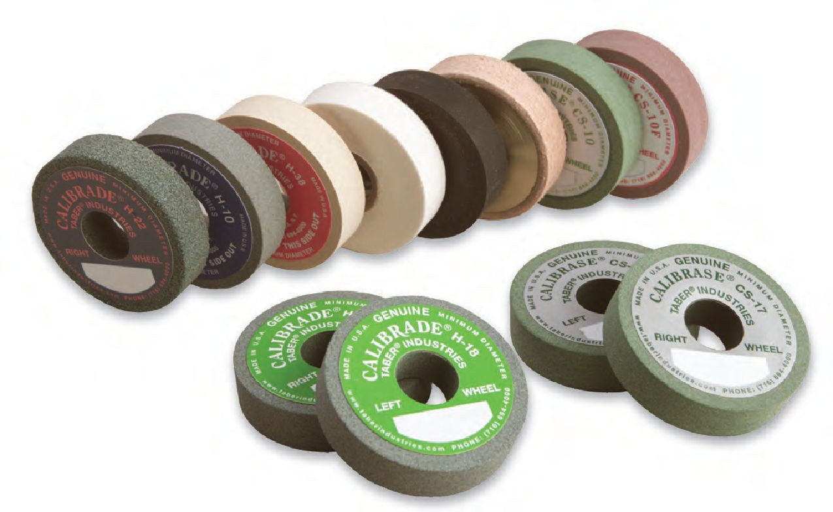
Study Overview
Taber Abrasion Analysis
CS17 wheel
Produces a harsher abrasion than the smoother CS-10 wheel
1,000 gram load
3,000 cycles - 500 cycles
Check the panels weight
Repurpose the wheel

Slide 16
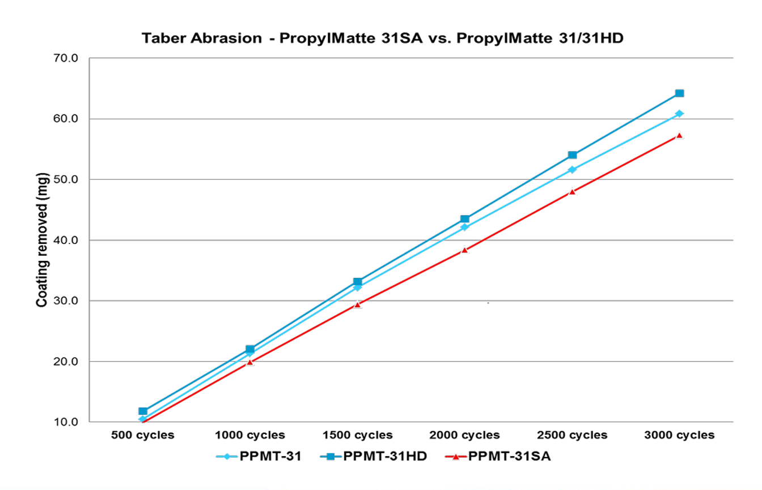
Study Overview
Coefﬁcient of friction (COF)
Static and kinetic
200g sliding sled - 0.1 inches/second
Measured by a force gauge
Measuring gloss of the cured ﬁlm
60° & 85°

Slide 17
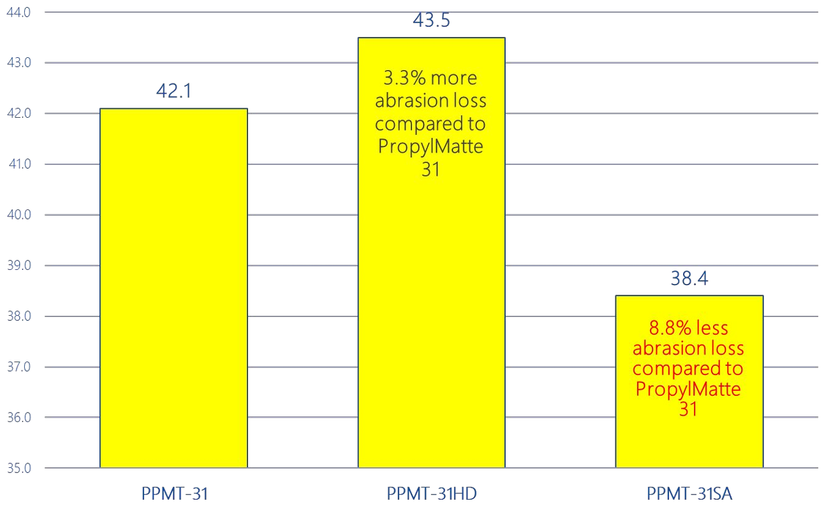
Coating removed after 2,000 cycles (mg)

Slide 18
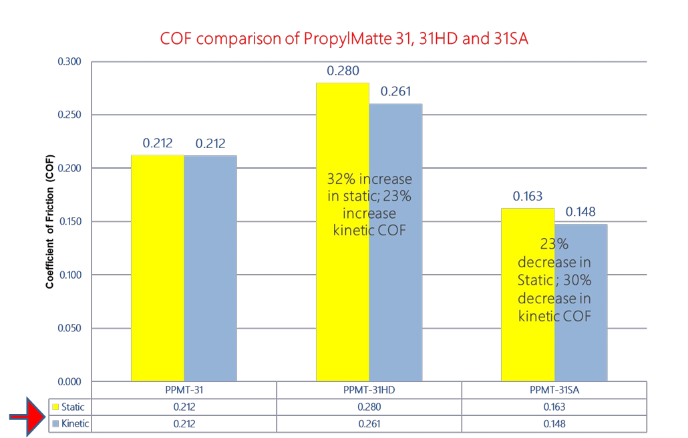

Slide 19
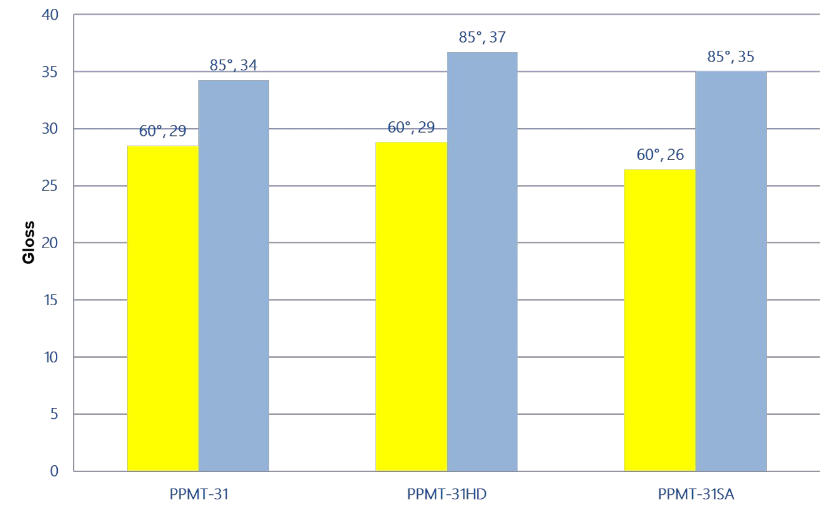
Gloss reduction at4.0% dosage (on TFW)

Slide 20
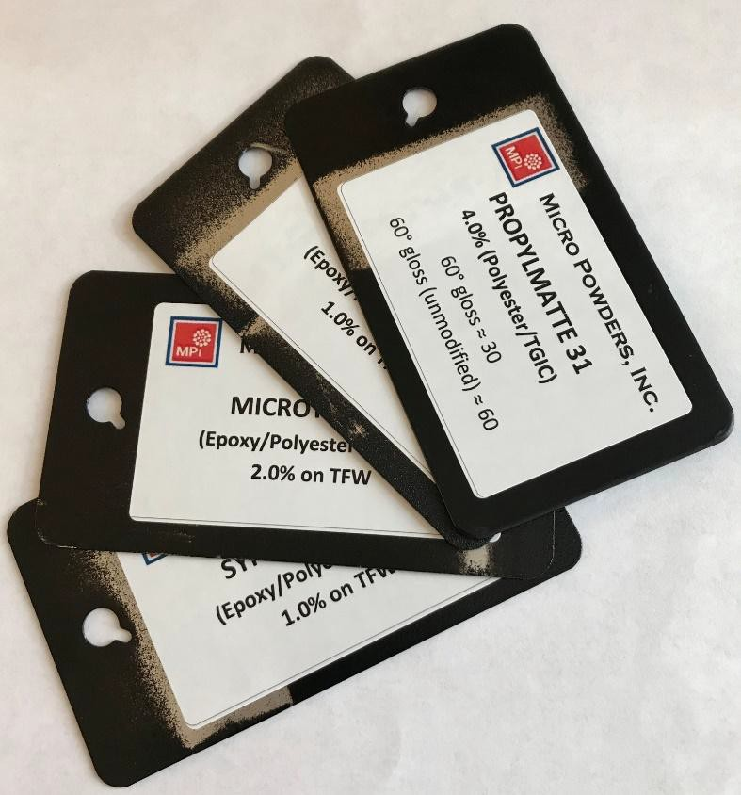
Powder Coatings Q-panels
Preferred dark (black) color
Demonstrates clarity
Common resin systems
Polyester/TGIC
Epoxy/Polyester Hybrid
Recommended % dosage
Formulations available upon request

Slide 21
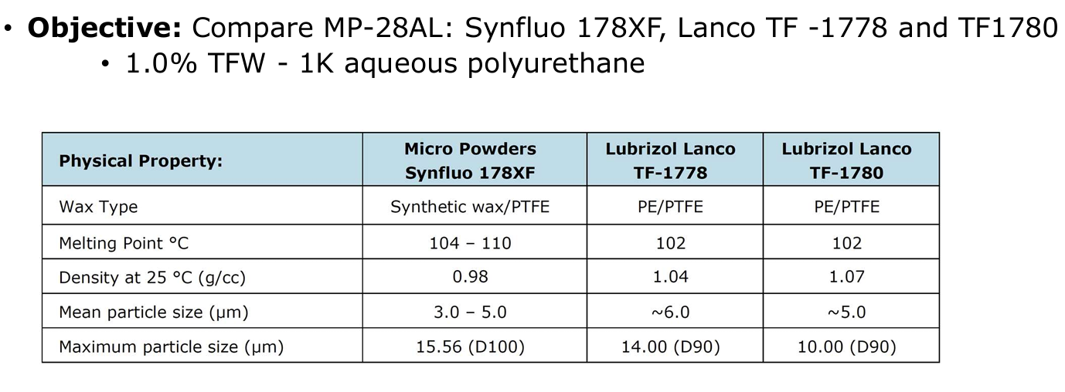
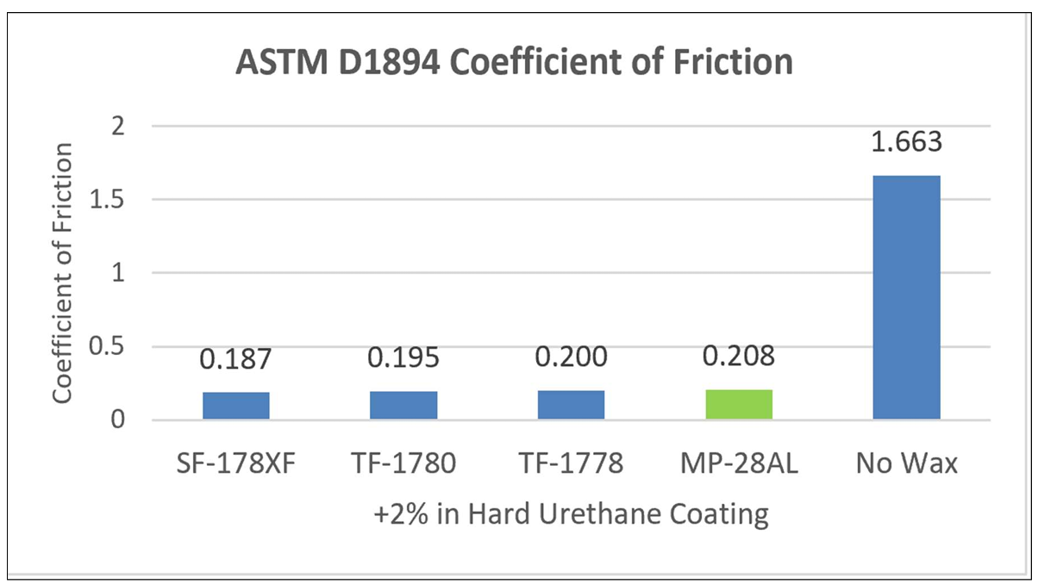
MP-28AL vs. Polyolefin Wax-PTFE

Slide 22
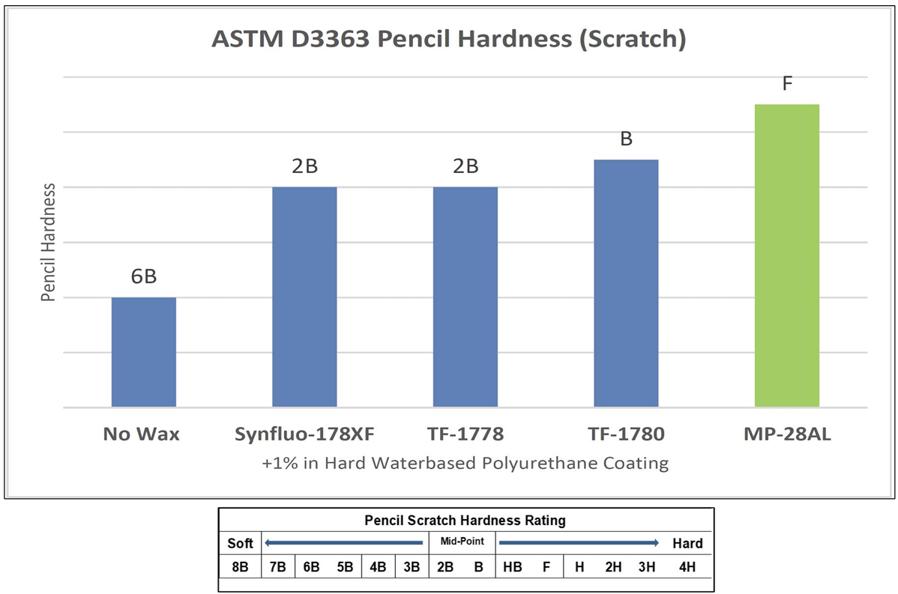
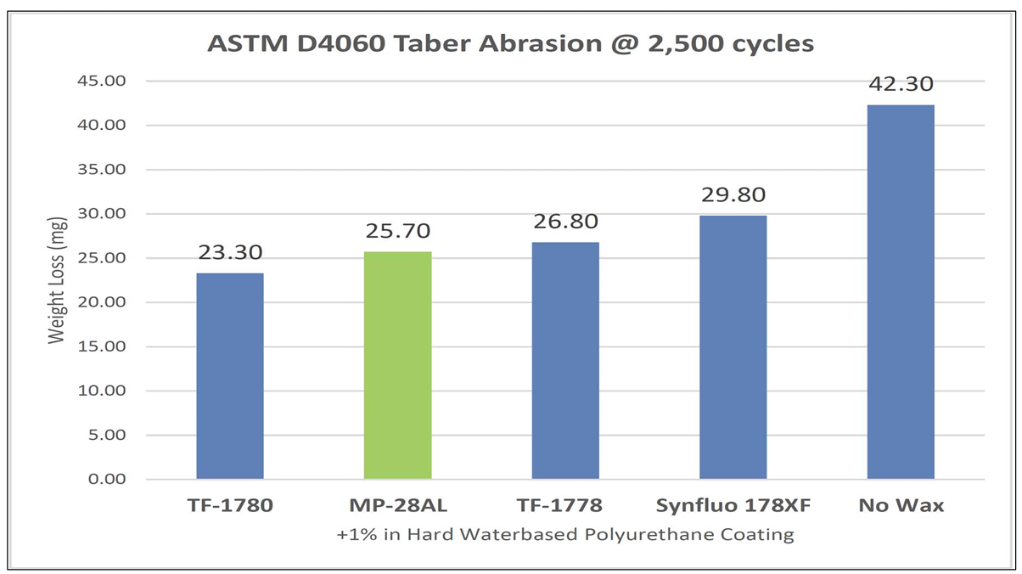

Slide 23
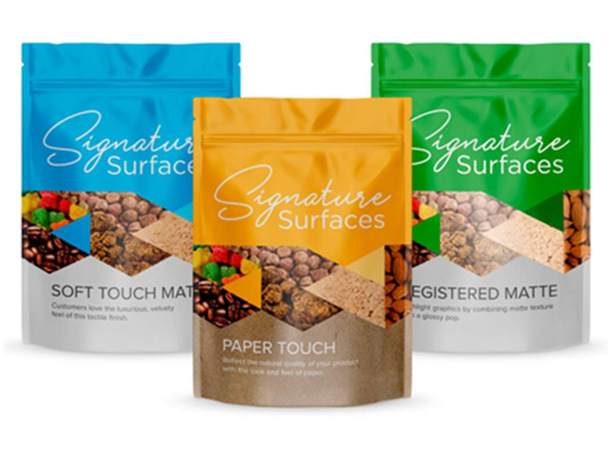
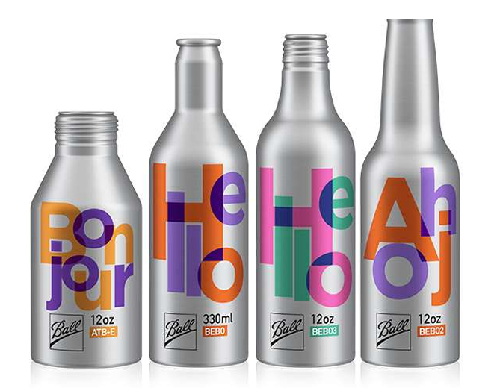
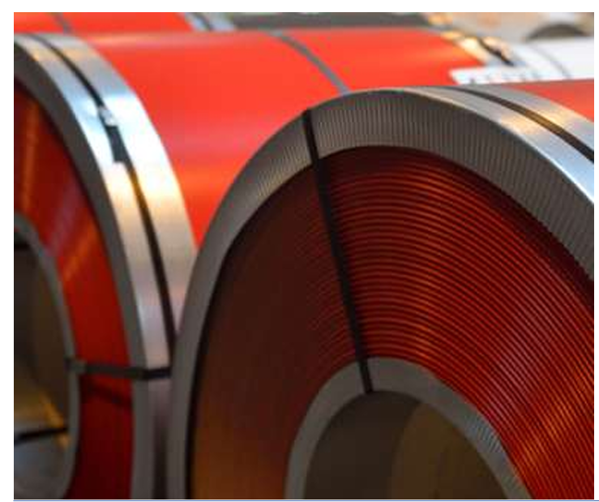
案例

Slide 24
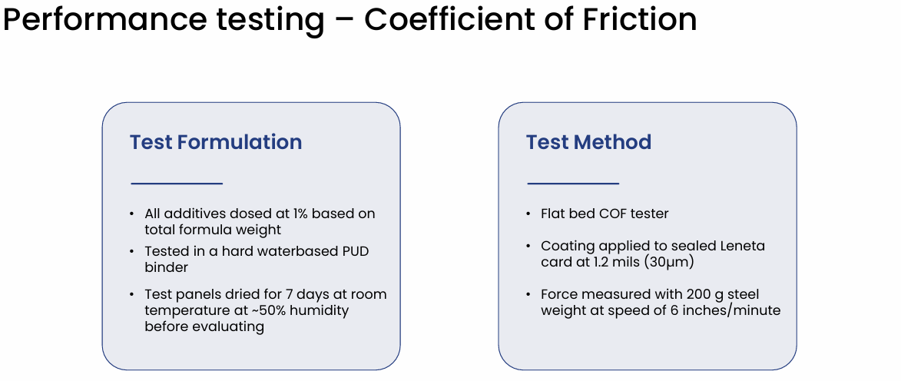
Performance testing – Coefficient of Friction

Slide 25
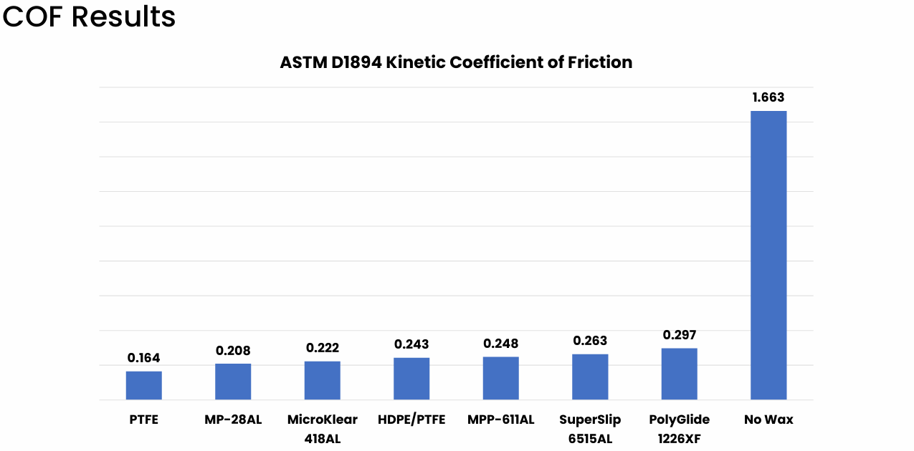
COF Result

Slide 26
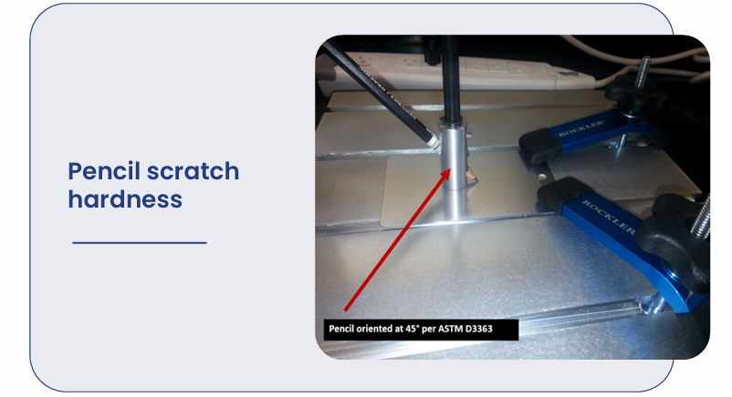
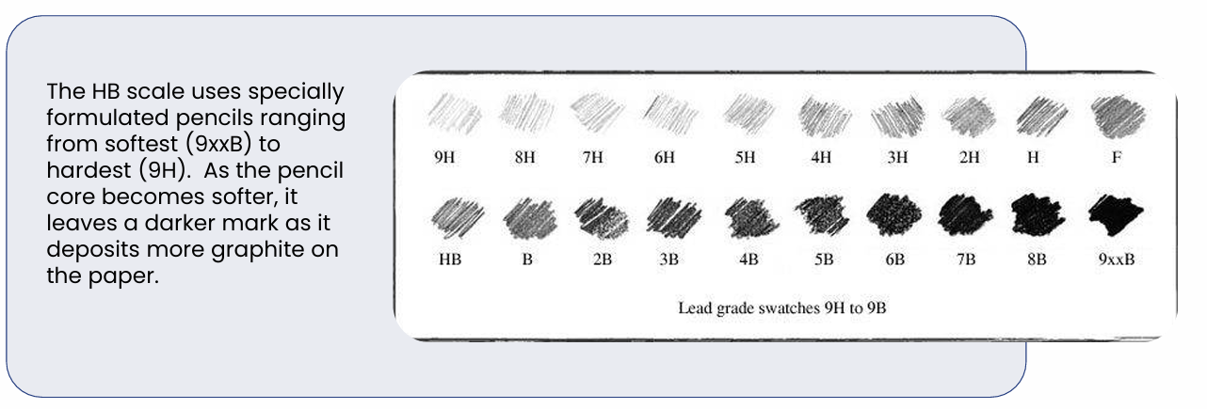
Scratch resistance testing

Slide 27
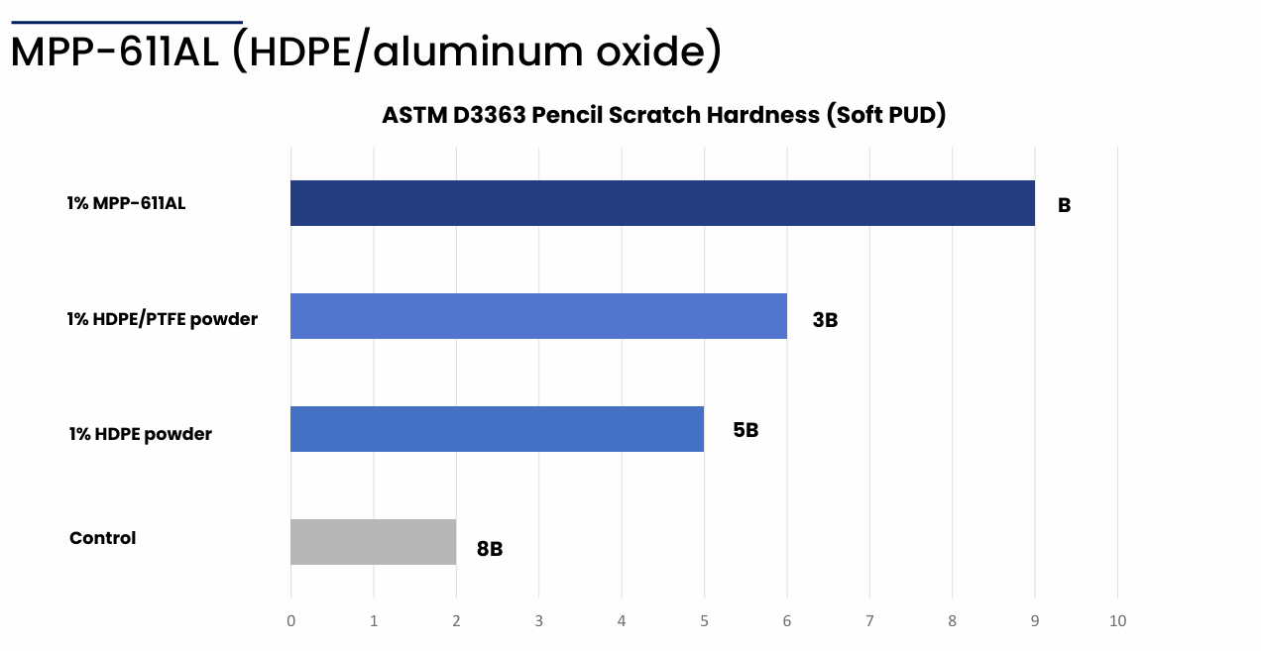

Slide 28
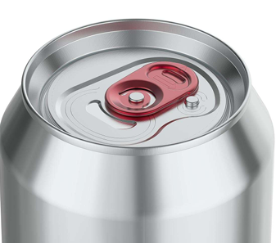
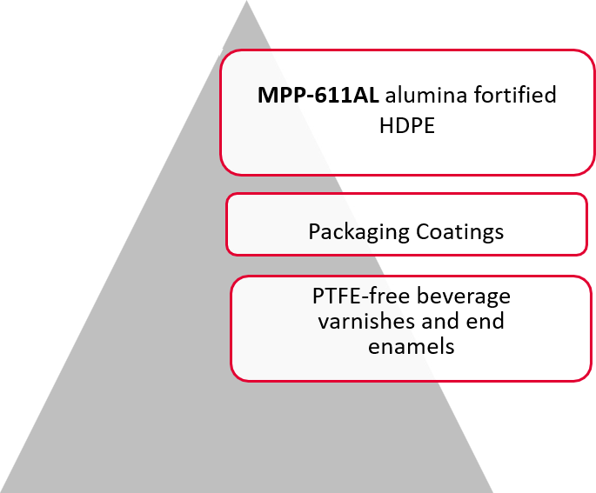
Türkiye: Axalta

Slide 29
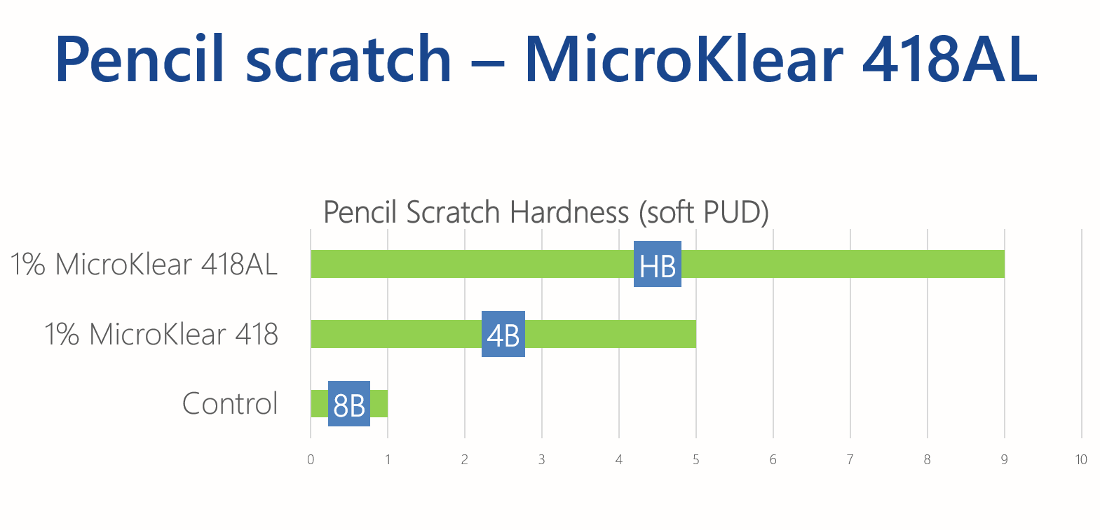

Slide 30
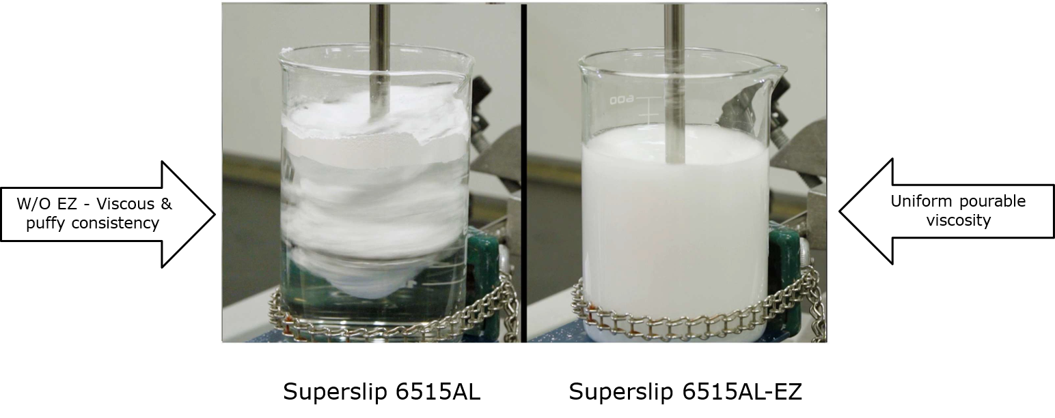
Dispersibility of Superslip 6515AL-EZ

Slide 31
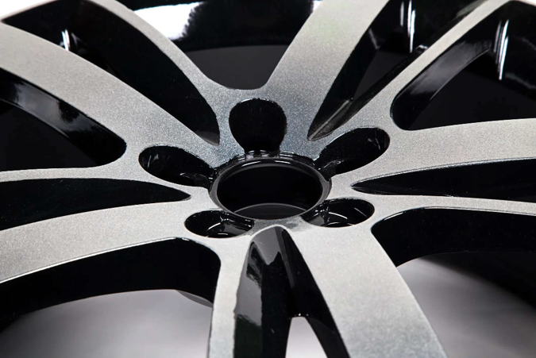
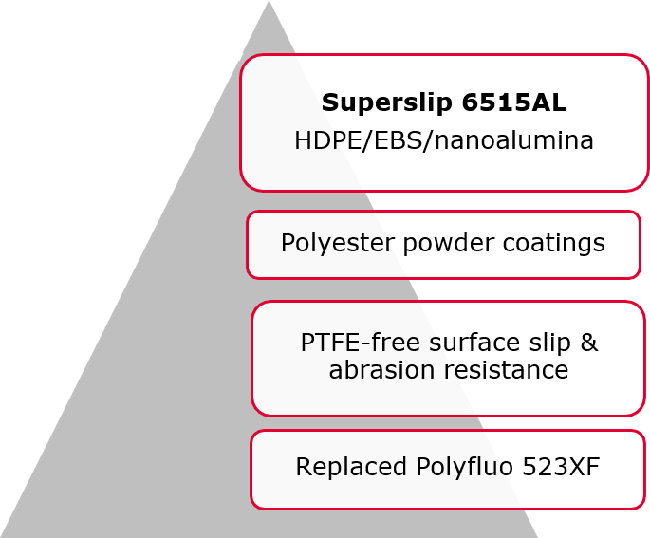
USA:

Slide 32
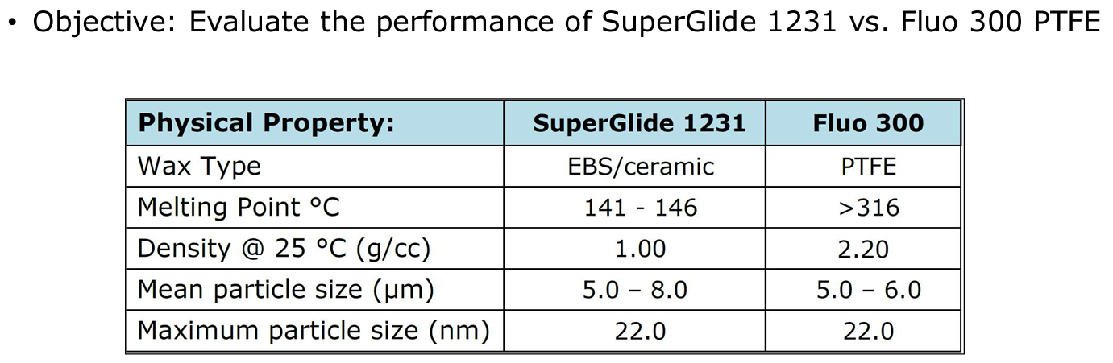
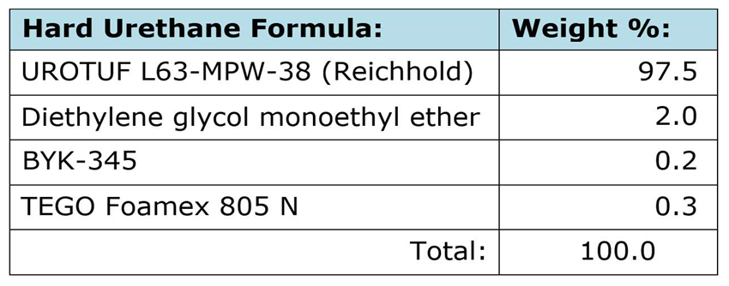
Performance Study

Slide 33
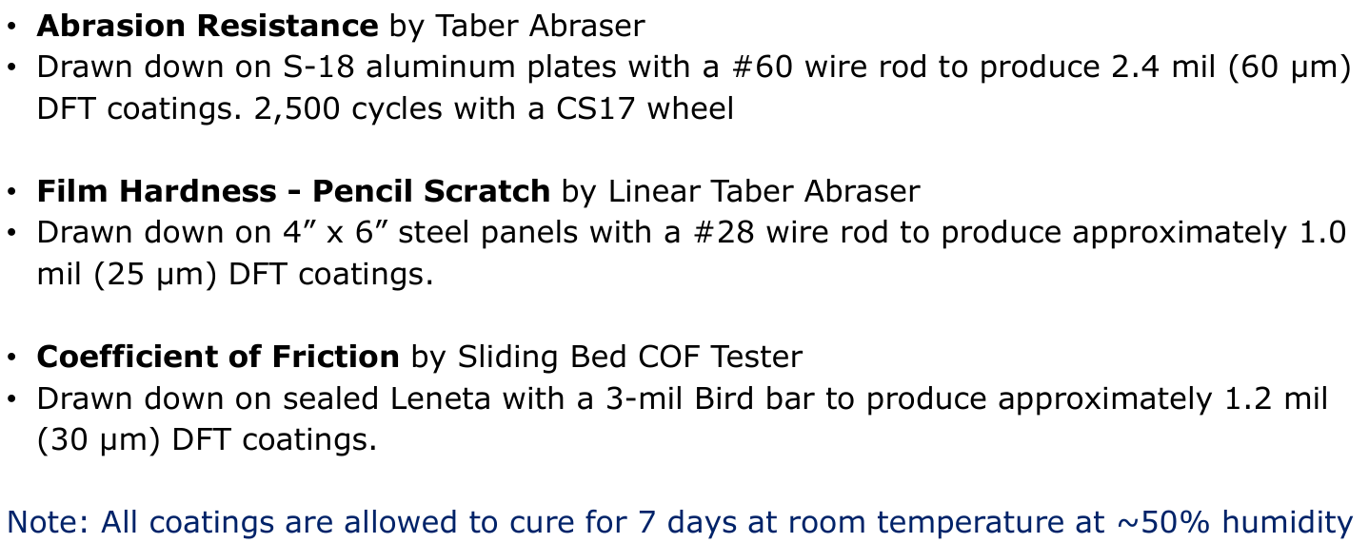
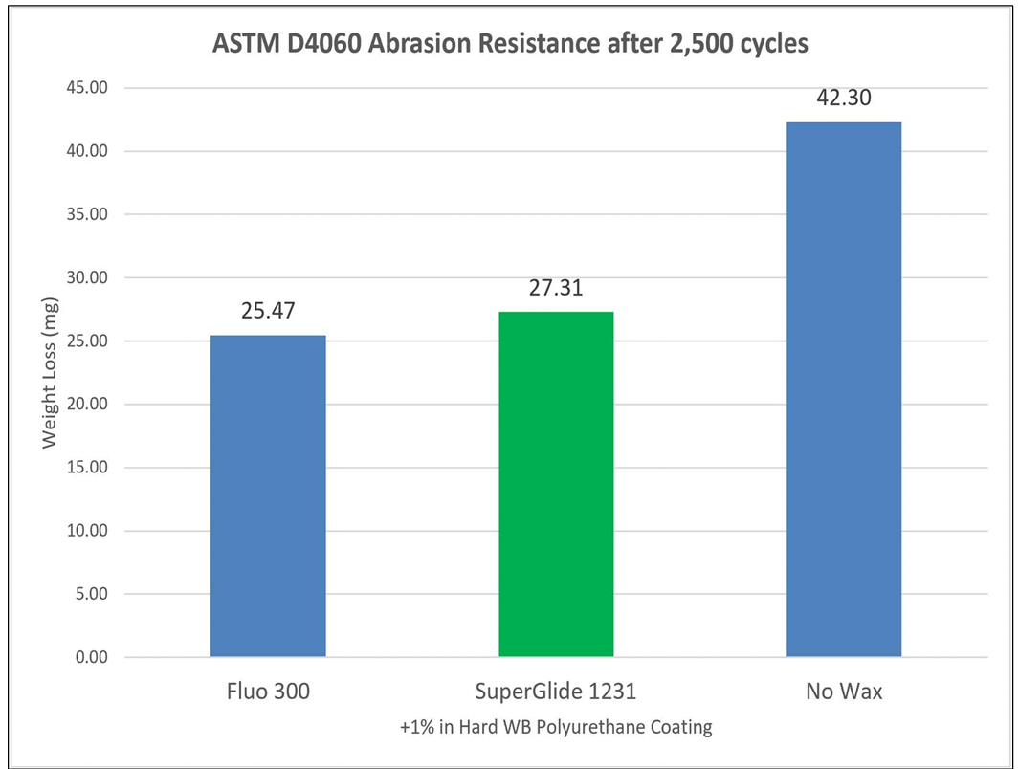
Test Methods

Slide 34
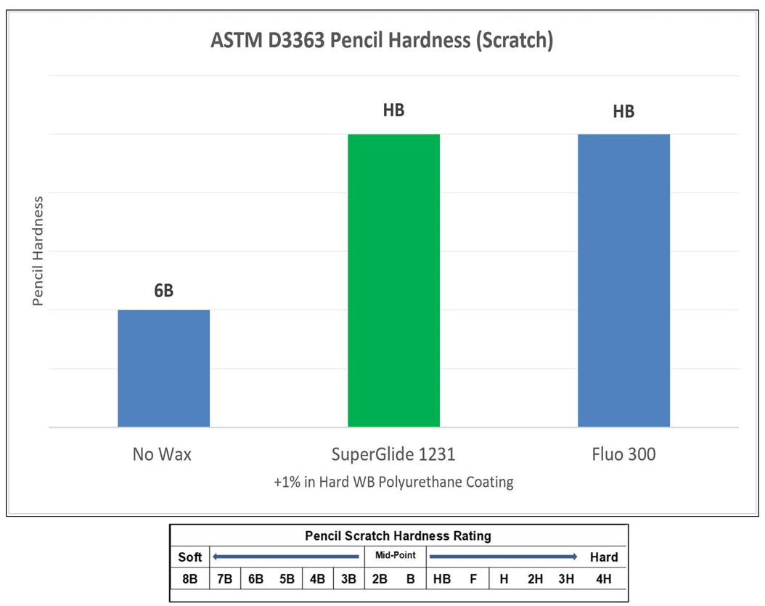
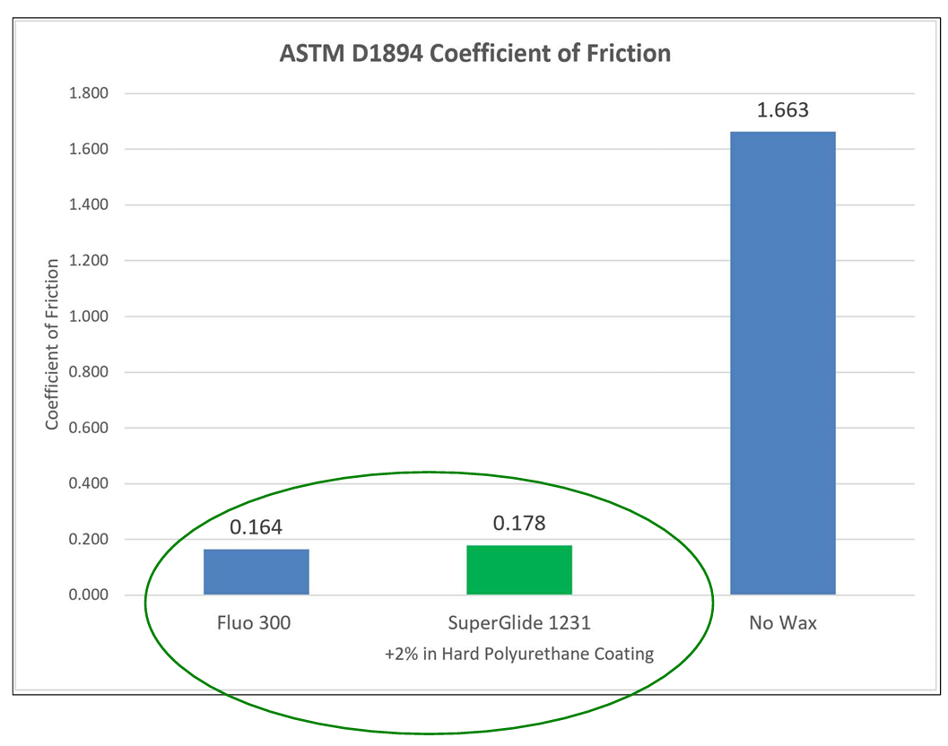

Slide 35

案例

Slide 36



Slide 37

Conclusions
PFAS-free protection in high specification coatings
PolyTuf 1229 provided similar pencil scratch hardness to Polyfluo 190
Superior Taber abrasion performance versus Polyfluo 190 and Polyfluo 900 with only 22.3 mg weight loss after 2,500 cycles

Slide 38


Industrial Wood finishes

Slide 39


GI, Protective & Marine

Slide 40


USA:Carboline (RPM)

